Slide 1
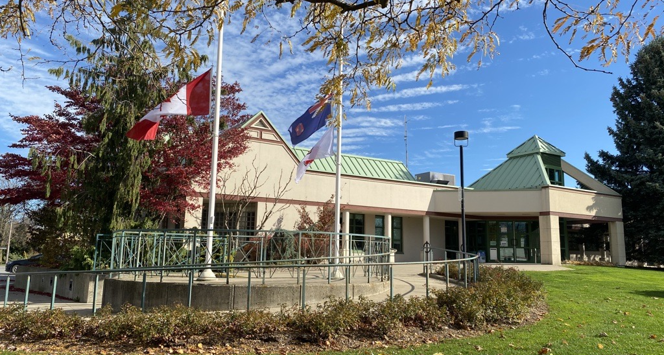
Safe Return to Council Chambers
Kevin Turcotte
Manager of Parks & Recreation
Council Meeting, August 30, 2021

Slide 2
Introduction
Staff have been directed to provide options for a safe return to the Council Chambers and are presenting three (3) options today.

Slide 3
Introduction
When developing the options, the following items were considered:
Safety measures
Provincial legislation
Public Health guidelines
Room capacities
Technology
Furniture layout
Costs

Slide 4
Ontario Regulations 364/20 – Rules for Areas Step 3
Under the current Ontario Regulations 364/20:
Section 2 – General Compliance
(7) A person shall wear appropriate personal protective equipment that provides protection of the person’s eyes, nose and mouth if, in the course of providing services, the person,
(a) is required to come within 2 metres of another person who is not wearing a mask or face covering in a manner that covers that person’s mouth, nose and chin during any period when that person is in an indoor area; and
(b) is not separated by plexiglass or some other impermeable barrier from a person described in clause (a).

Slide 5
Safe Return to Council Chambers: Options
Continue Virtual Meetings
Hybrid Meetings
In-Person Meetings

Slide 6
Current Measures/Installations
In 2020, measures were implemented to keep people safe at Town Facilities.
The plan included, but was not limited to:
Workplace risk hazard assessments
Barriers at customer service desks
Room capacities
COVID-19 signage
Development of an online screening tool
Screening desks/areas
PPE (e.g. masks, goggles, etc.)

Slide 7
Option 1 – Continue Virtual
Continue meetings in current format connecting remotely using Microsoft Teams application
Council / Members of the public would continue to participate in / view COTW/Council meetings through Livestream
Delegations would continue to be invited to participate via Teams

Slide 8
Option 1 – Continue Virtual
This option would be assessed on an ongoing basis dependent on emergency order status and conditions in the Exit from the Stage 3 of the Roadmap to Reopen.
Another consideration may be timing in parallel with Escribe (new meeting management solution).

Slide 9
Pros & Cons – Virtual
PROS | CONS
Digital participation is familiar to Council, staff, and the public | Interactions between participants are more difficult
Allows for electronic participation from any location | Occasionally, there are technical challenges
No masking or physical distancing requirements | Less dynamic meetings
Easily accessible, meets AODA requirements, Council Chambers has capacity limits for in-person | Some of the public has expressed concern with not being able to participate in-person

Slide 10
Costs – Virtual
There is no additional costs to the Town with this option.
The cost of Teams is included in the Operating Budget. (E-scribe is included in the Modernization grant.)

Slide 11
Option 2 – Hybrid
Lord Mayor, Council members and Town Clerk physically in Council Chambers
SMT attends in Town Hall in various meeting rooms
Other Staff & delegations will attend remotely using Microsoft Teams
Members of the public and the media will view COTW/Council meetings through Livestream

Slide 12
Layout – Hybrid
Cllr
Cllr
Cllr
Cllr
Clerk
LM/
Chair
Cllr
Cllr
Cllr
Cllr
Total
10 people
* Under the current O. Reg 364/20, limits to 50% capacity with 2-metres physical distancing & other requirements.

Slide 13
Capacity – Hybrid
Virtual
In Person
Lord Mayor
Councilors (8)
Town Clerk
SMT (but in separate meeting rooms)
Microsoft Teams:
Staff
Delegations
Livestream:
Media
General Public

Slide 14
Pros & Cons – Hybrid
PROS | CONS
Allows for in-person interaction between Council members | Awkward layout because of physical distancing (Council members can’t face one another)
Familiarity with in-person meetings (more traditional Council meeting structure) | Potential technical challenges: Camera coverage is of full room, not individual faces Still need to log into Teams May be difficult to hear the speakers In-camera difficulties
Safety via physical distancing is achieved at a minimal cost | SMT are in different rooms and some Staff is attending remotely
Meeting is more dynamic | Potentially difficult to hear speakers

Slide 15
Costs – Hybrid
Costs associated with this option:
Estimate for Additional furniture (tables) – $500 + HST

Slide 16
Option 3 – In Person
This option will use the regular in-person model
Includes all Council members, Senior Staff, and some staff in Council Chambers
Media and members of the public would view COTW/Council meetings through Livestream

Slide 17
Layout – In Person
= new glass partitions
= existing tables
= new tables
= gallery chair
Dir
Staff
Cllr
Cllr
Cllr
Dir
Staff
Clerk
Cllr
LM/
Chair
Total = 25
17 Town
6 Additional Staff &/or Delegates
Dir/ CAO
Cllr
Dir
Staff
Cllr
Cllr
Cllr
Dir
Staff
* Under the current O. Reg 364/20, limits to 50% capacity with 2-metres physical distancing & other requirements.

Slide 18
Capacity – In Person
In Council Chambers (25):
Lord Mayor (1)
Councilors (8)
CAO (1)
Town Clerk (1)
Directors (4)
Staff (4)
Delegates and/or Additional Staff (6)
Virtual:
Staff
Media
General Public
* Note:
There are capacity limitations in Council Chambers. Therefore, for additional people, an alternative location for Council would need to be investigated.

Slide 19
Pros & Cons – In Person
PROS | CONS
Allows for in-person interaction between Council members | There are costs associated with physical distancing barriers
Familiarity with in-person meetings (more traditional Council meeting structure) | Renovation costs are unbudgeted There are potential future costs to return Chambers to the original state
Layout is improved for Council members (face-to-face layout) | There are still capacity limits in Council Chambers
Safety is achieved (via partitions) while still allowing for an in-person meeting | There isn’t sufficient space for all Council, Staff, Media, and the public in the Council Chambers under the current legislation
Meeting is more dynamic

Slide 20
Costs – In Person
Installing partitions – Lord Mayor’s desk, Councillors’ desks, staff desk, press desk
Estimate - $17,740 +HST

Slide 21
Sample of Completed Work

Slide 22
Partitions Completed
Town Hall – Front Desk
Town Hall – Planning Desk
Operations Centre – Front Desk
Community Centre – Front Desk
Library – Front Desk

Slide 23
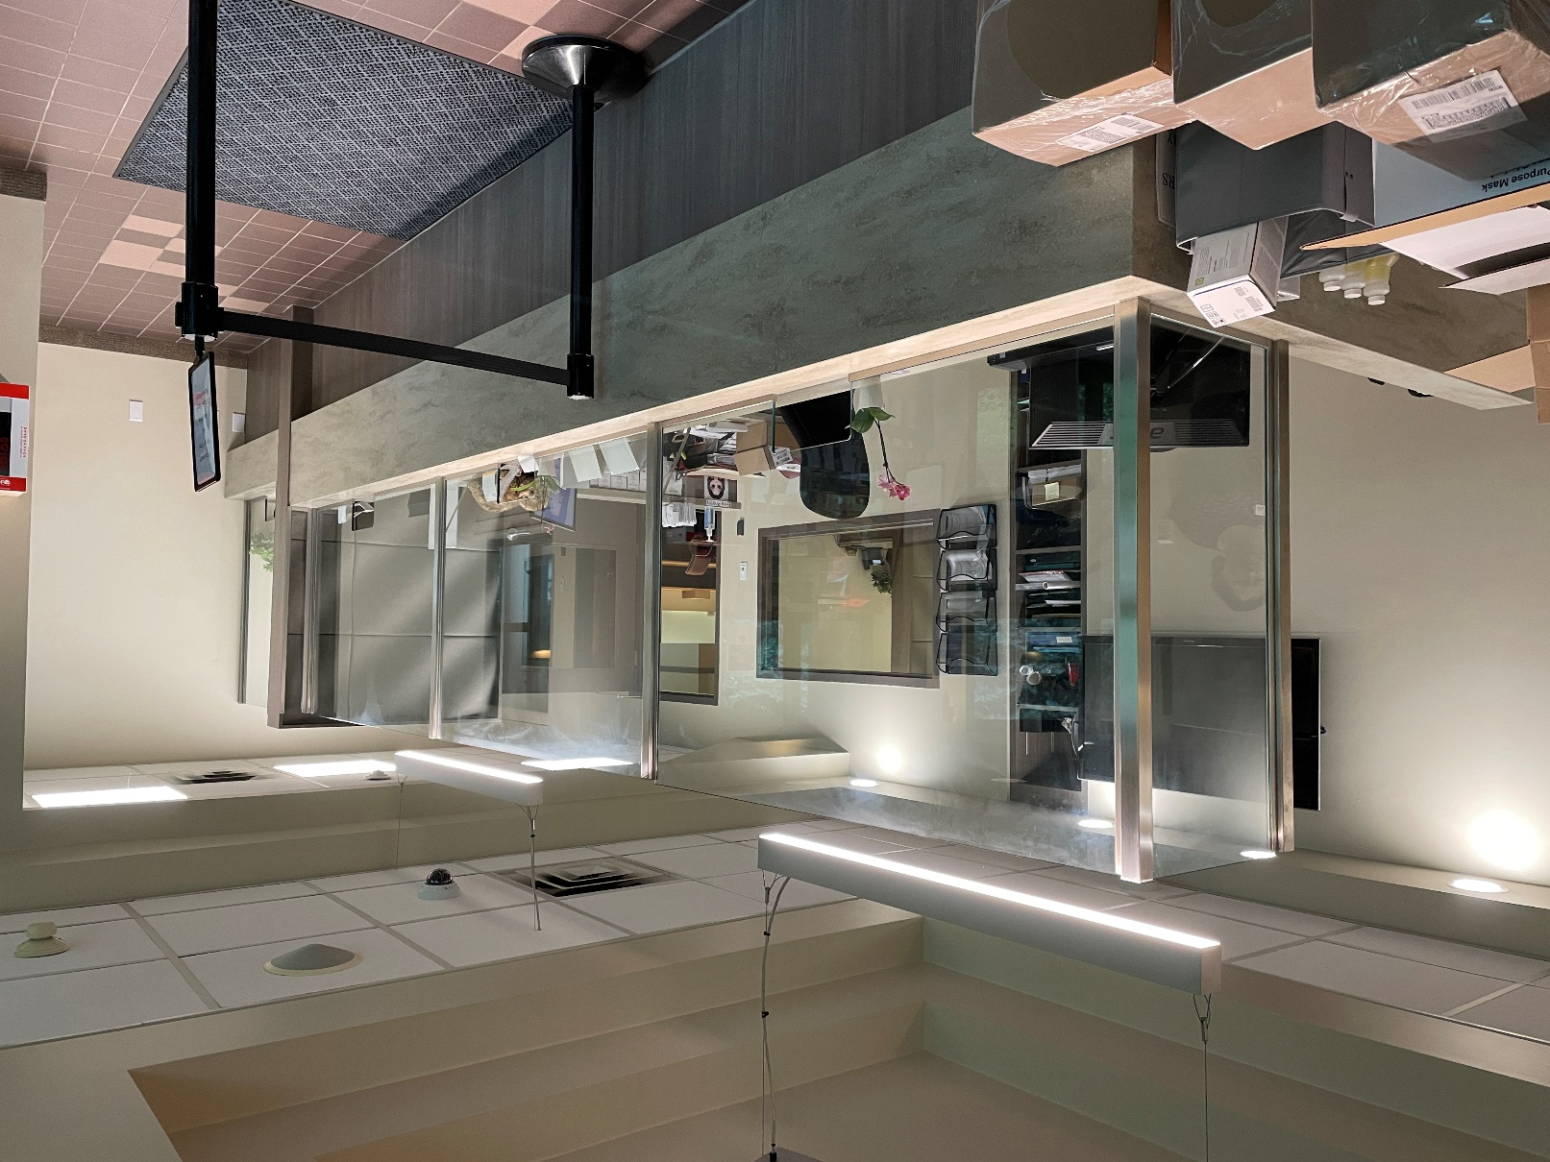
Town Hall – Front Desk

Slide 24
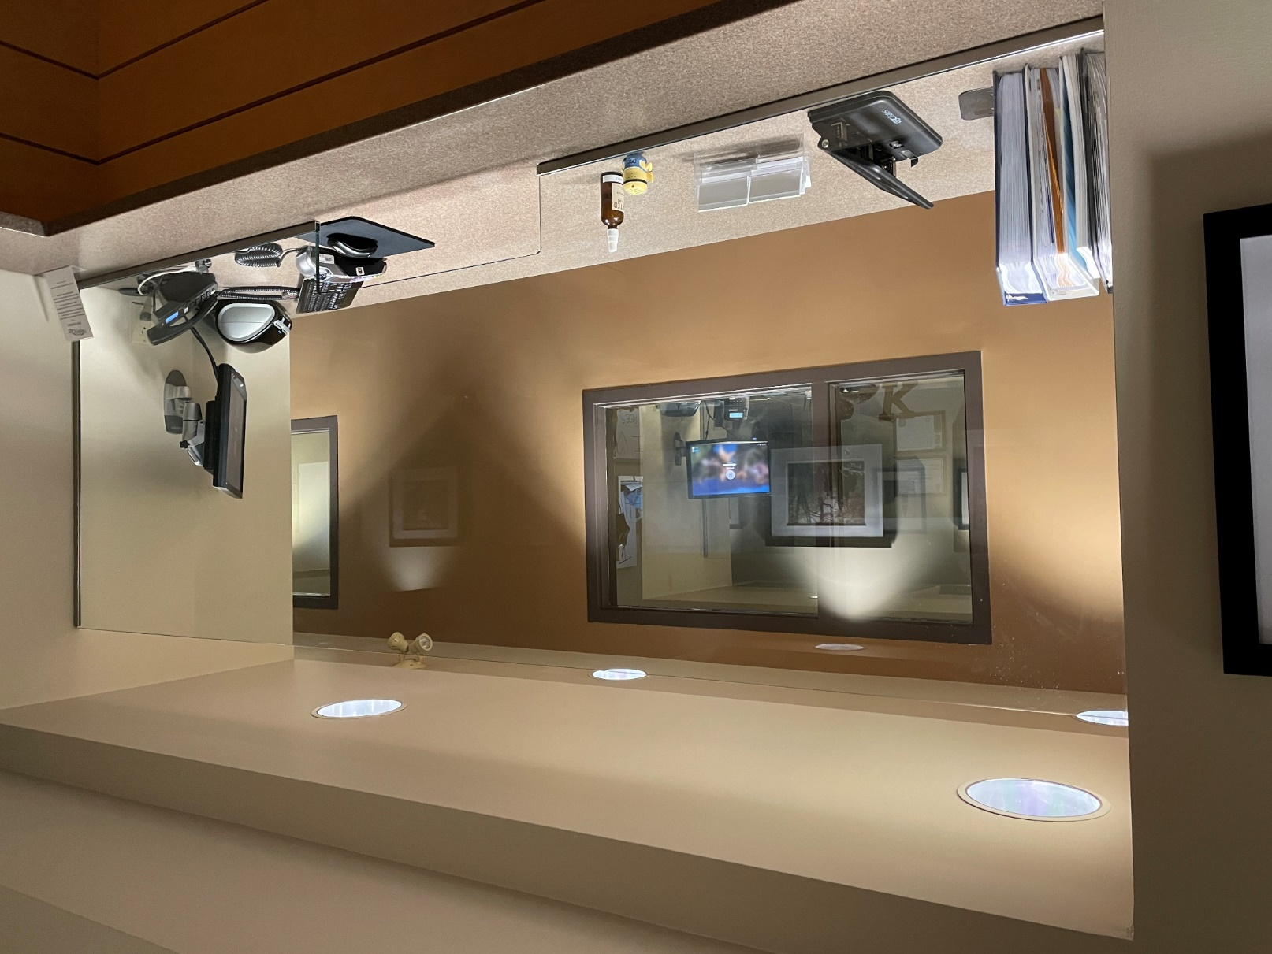
Town Hall – Planning Desk

Slide 25
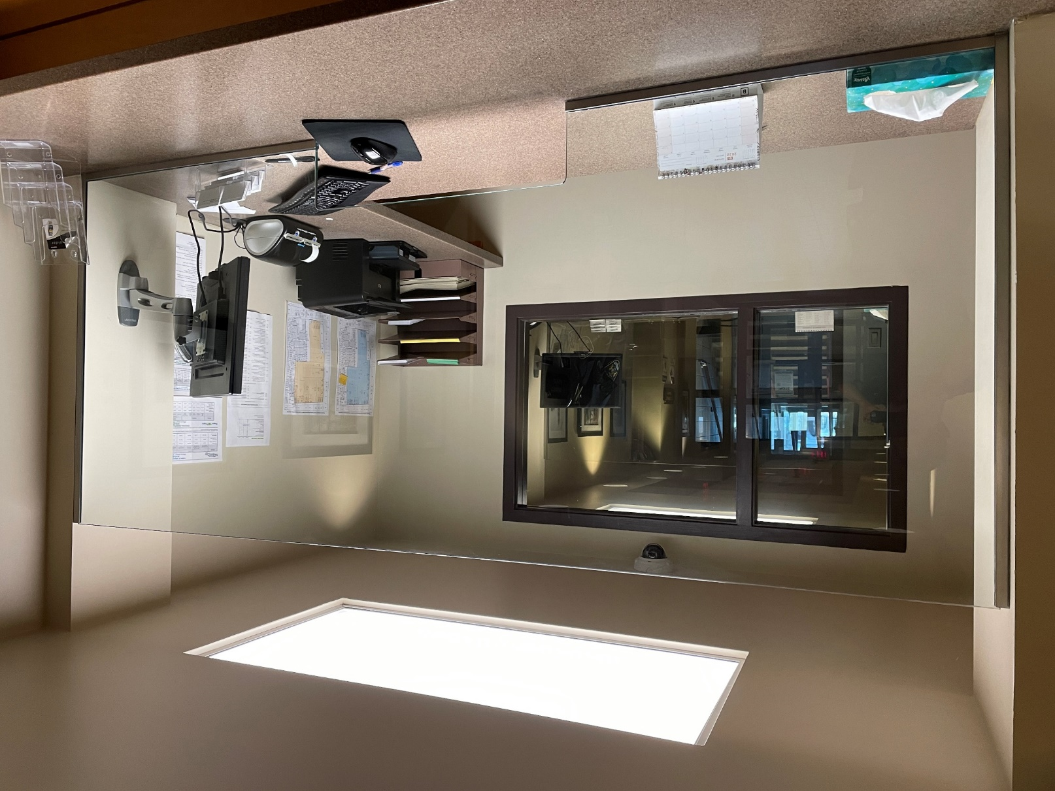
Town Hall – Planning Desk

Slide 26
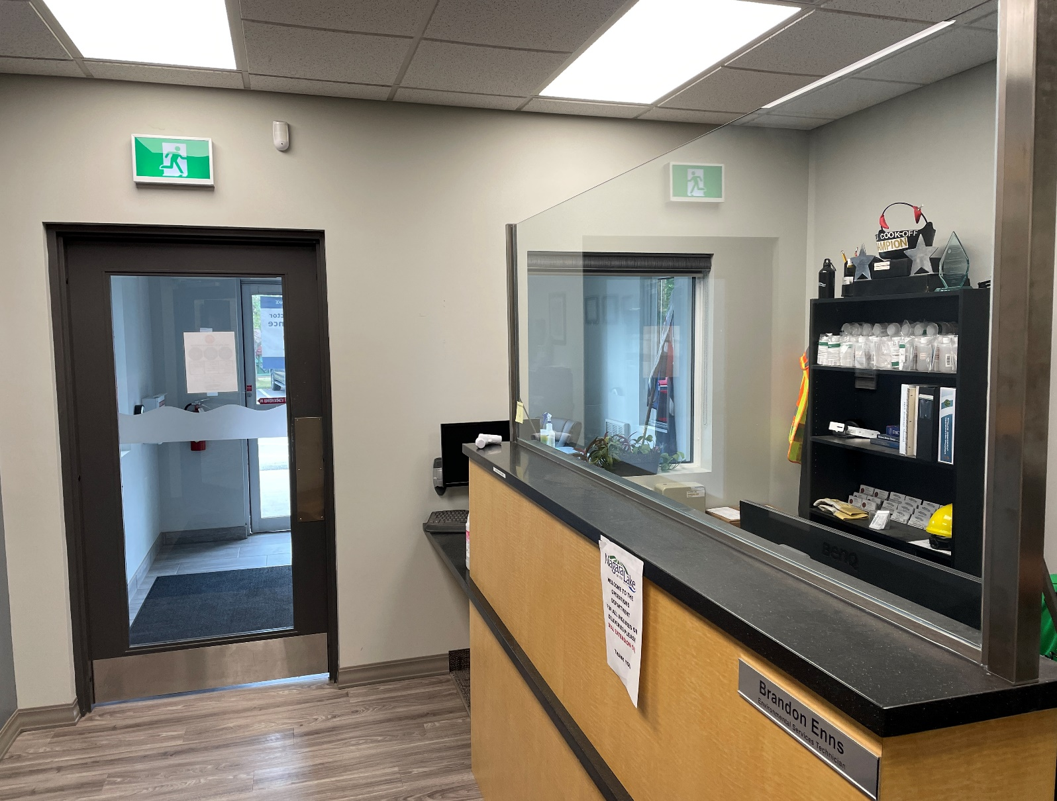
Operations Centre – Front Desk

Slide 27
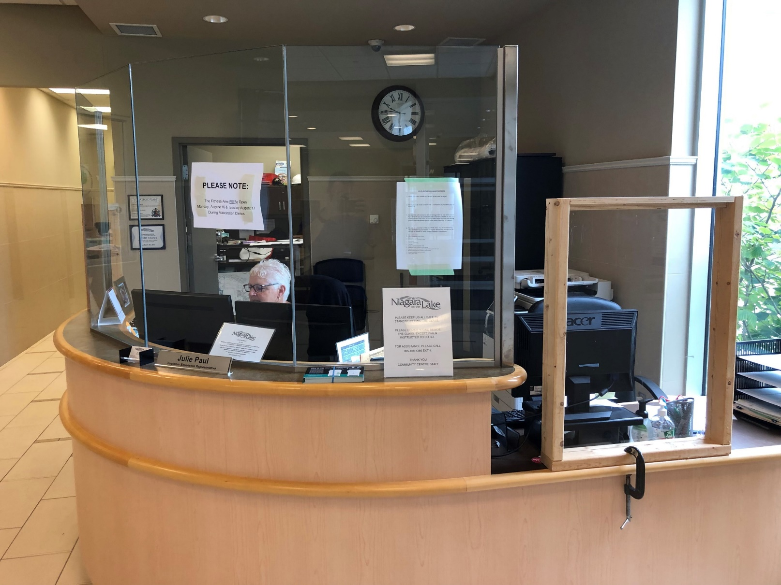
Community Centre – Front Desk

Slide 28
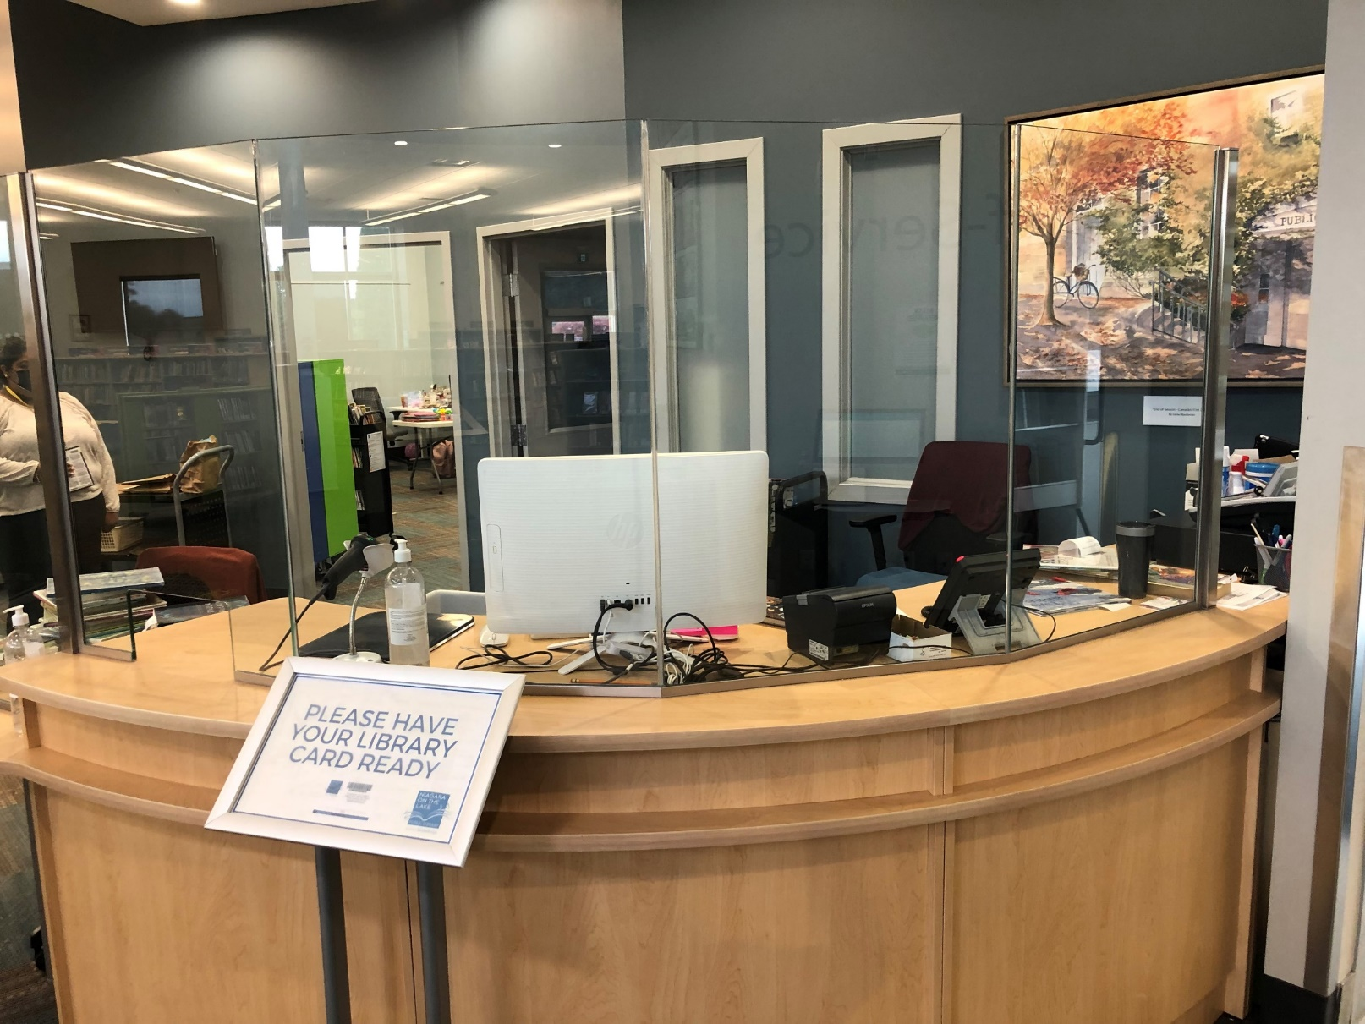
Library – Front Desk

Slide 29
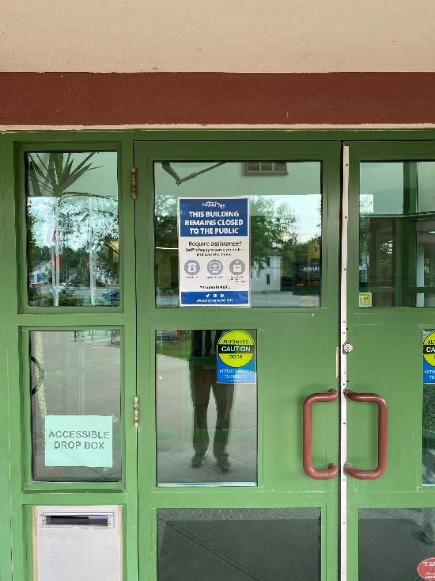
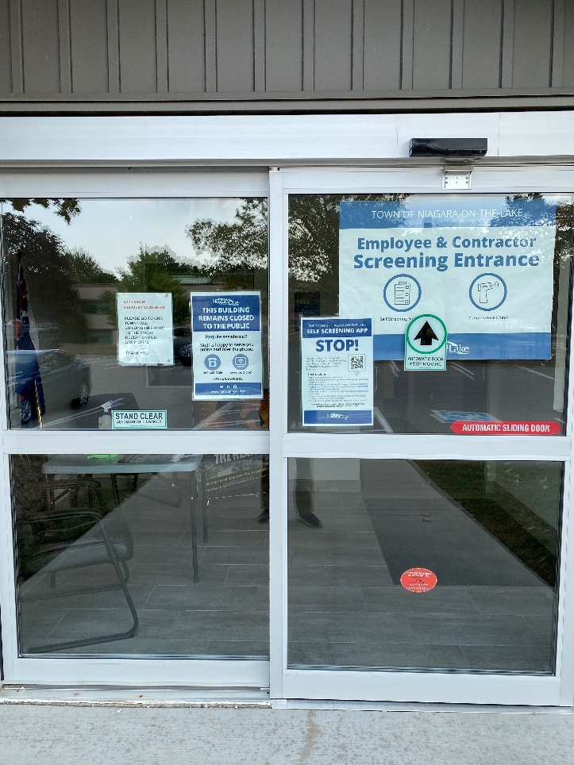
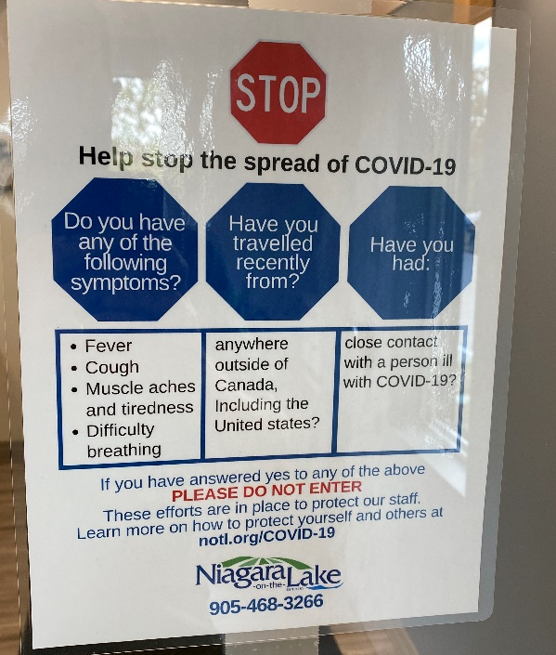
COVID-19 - Signage

Slide 30
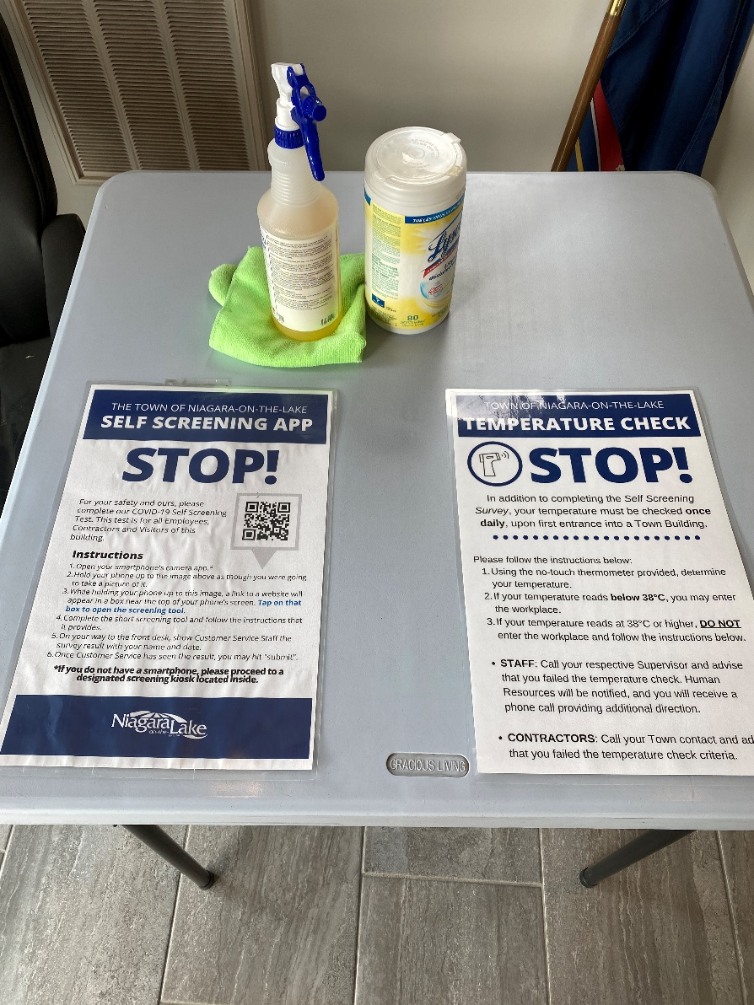
Staff Screening Desks

Slide 31
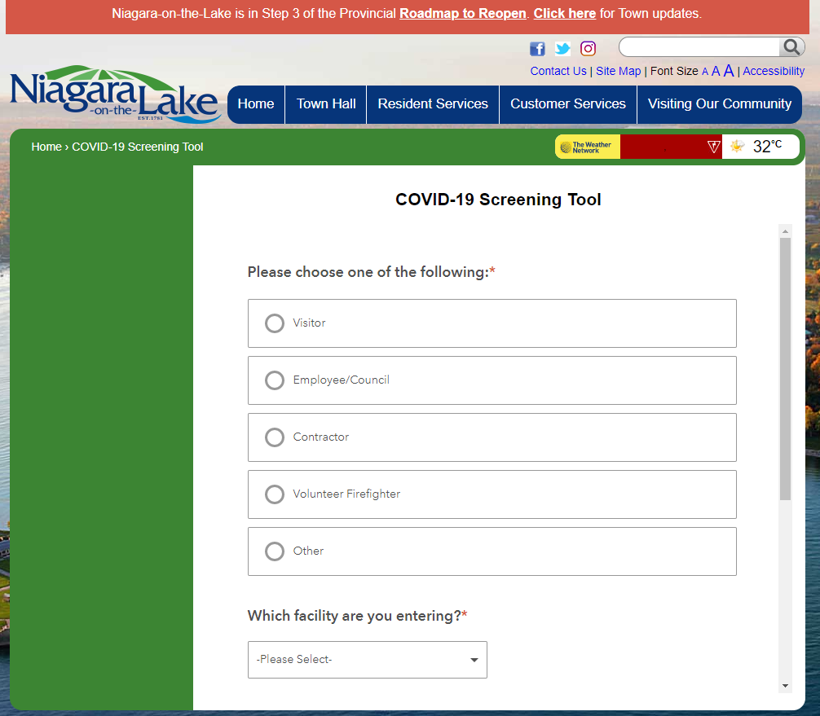
Town of Niagara-on-the-Lake COVID-19 Screening Tool
www.notl.com/screening

Slide 32
Thank you.
Any Questions?

