Slide 1
What do you want to be remembered for? Having a vision Fiscal Sustainability

Slide 2
The Presentation will include
1. Strategic Plan and LM Economic Task Force
2. Our Financial Obligations in Capital Costs
3. What is possible
4. How we pay for it

Slide 3
Strategic Plan
Pillar - Protect Distinctive Community Assets
Objective: Preserve unique community elements
Objective: Close the gap on capital investments
Objective: Recognize the importance of tourism in Niagara-on-the-Lake

Slide 4
Objective: Preserve unique community elements
Tactics
•Review all existing studies that apply to community asset management and heritage protection, and create a prioritized action plan
Action Items:
•Update the Heritage Conservation District plan, including the possible expansion of heritage district boundaries
• Support residences and businesses in protecting their valuable heritage assets
• Promote the importance of heritage assets as an economic driver of the Town

Slide 5
Objective: Close the gap on capital investments
Tactics
• Find ways to close the gap on capital investments including approving a realistic 10-year capital plan
Action Items:
• Create an asset management inventory, showing investment needs prioritized against a 10-year investment horizon
• Create realistic priorities by aligning future infrastructure investments into a capital reinvestment plan

Slide 6
Objective: Recognize the importance of tourism in Niagara-on-the-Lake
Tactics
• Actively steward heritage, agricultural, wine and cultural assets for the benefit of residents and tourists
Action Items:
• Partner with tourism partners to ensure a robust tourism strategy is developed.
• Protect our agricultural, heritage and cultural assets through policy and bylaw enforcement
• Address rising traffic issues, through analysis and underlying issue identification

Slide 7
Lord Mayors Economic Development Task Force
Strengthen the budget aimed at creating a diversified, balanced and sustainable tax base
Diversify our employment profile and related opportunities
Create a notable shift in our demographic profile

Slide 8
Objective -Enable the development of a Service Delivery Culture, and provide strong economic development leadership
Prioritize delivery of infrastructure needs – including but not limited to:
Embedding transportation, infrastructure, facilities, public realm and other municipal assets as vital to Economic Development planning;
Planning for transportation and traffics shifts as part of business attraction and development discussions;
Ensuring we are leveraging Provincial and Federal grant opportunities to extend our infrastructure budgets.

Slide 9
SP - Find Ways to Close the Gap on Capital EDTF - Strengthen the Budget – diversified and sustainable
Town Council’s Four Obligations to Capital
10 year capital budget projections
Facilities Master Plan
Agriculture, Irrigation Master Plan
Tourism Capital

Slide 10
10 year capital budget
The requirement is approximately $17.1 mil per year over the next 10 years and we are currently have $6.5 mil per year to spend.
There is a shortfall of $10.6 mil

Slide 11
Facilities Master Plan 2017

Slide 12
Agriculture Irrigation Funding
The irrigation system works through a series of ditches which
are supplemented with water in several locations throughout
the Town with large pumps delivered through a
series of underground piping.
The pumps, pump houses and pipe works within the Town is
valued at millions of dollars which is paid by a group of 165 farms.
Some of this infrastructure dates back to the 1990’s which
was constructed and debentured by the Town of Niagara on the
Lake as a partner.
This infrastructure gets paid back as part of the capital costs
on a per acre charge to each of the 165 farms until it is paid back
and the capital costs stay in place to replenish major repairs
of full replacement of the infrastructure.
On top of the capital costs these farms also pay a maintenance
cost on a per acre charge to cover general works, like ditching,
vegetation removal, minor pipe and pump repairs, etc.

Slide 13
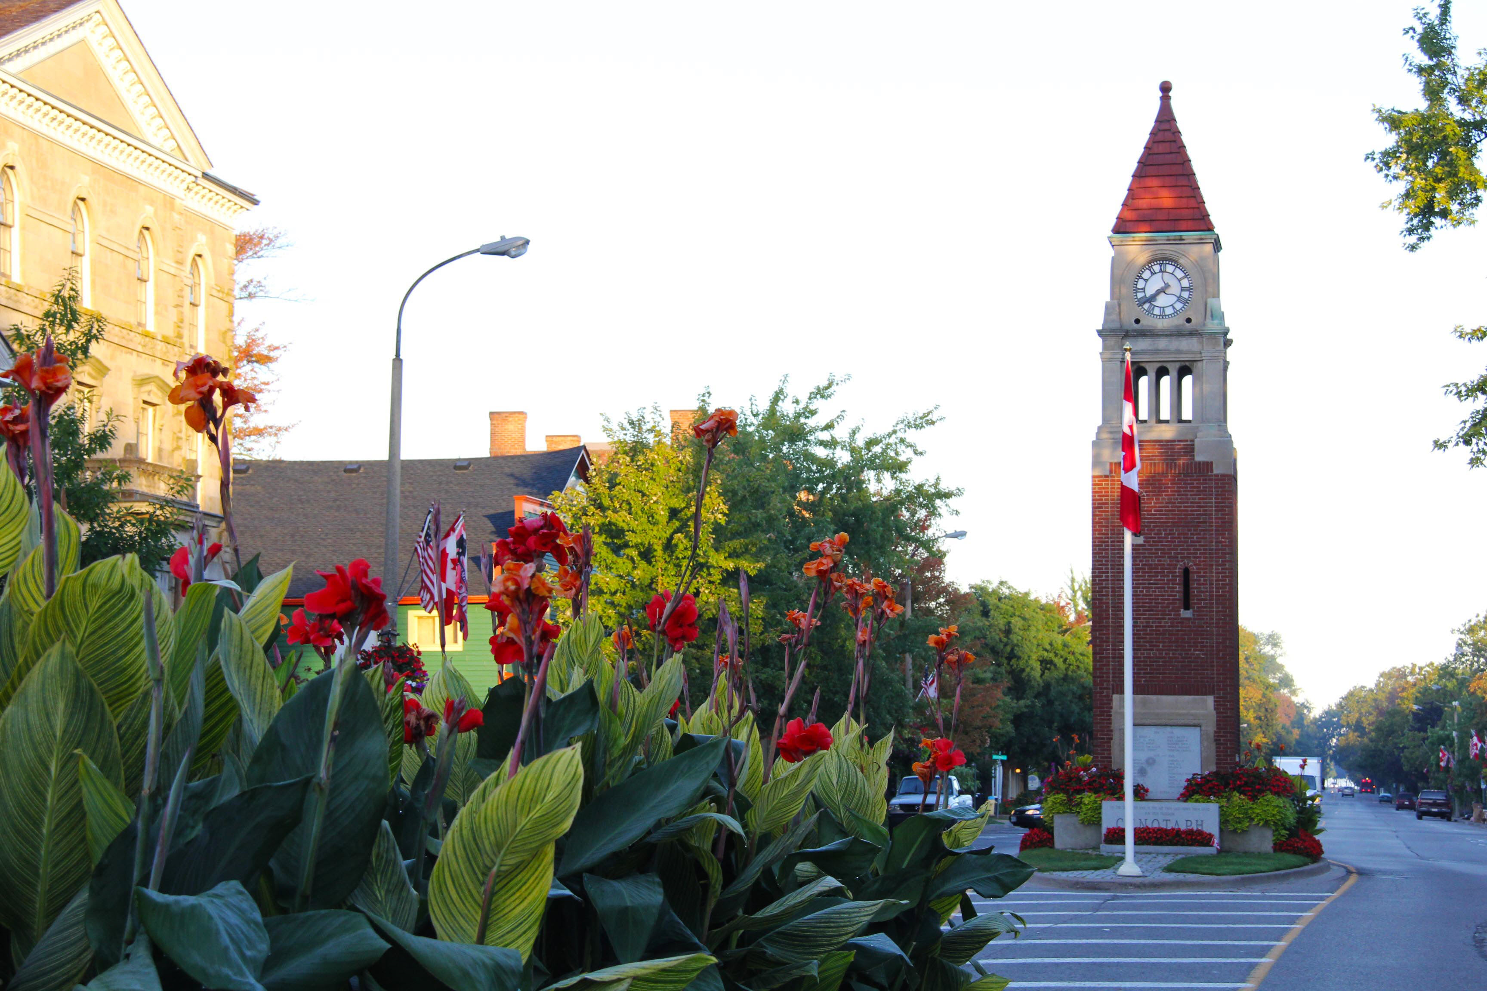
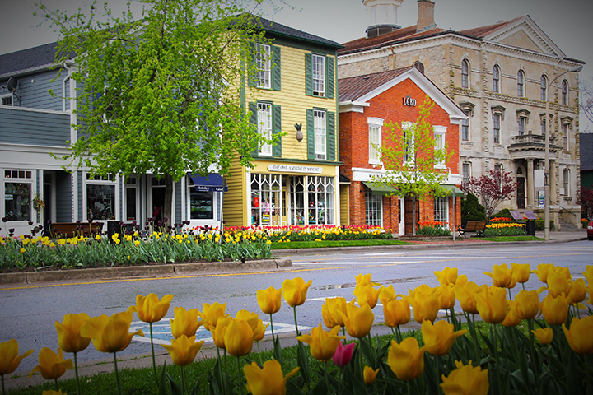
Tourism Capital Opportunities with Partners

Slide 14
Glendale Diverging Diamond Enhancement

Slide 15
Niagara Region Requirement
Staff have provided high-level budgetary numbers for the elements for cost-sharing with the Town as MTO has released their design assignment and these have been included as part of the scope:
Decorative Lighting +/- $100,000 (my understanding is that Municipal Staff have confirmed no funding available but it has been included in the RFP as its easier to decrease the spec versus increase)
Upgrades to the Roundabout (based on recent tender closing costs)
o Landscaping Upgrades (Plantings) +/- $14,000
o Irrigation +/- $11,000
o Electrical +/- $5,000

Slide 16
Town of NOTL – next steps
Once the Town confirms their intent for the decorative lighting upgrades, the Region will then provide a Letter of Commitment to the Town based on the current estimates.
Cost-sharing repayment could be deferred to the end of the contract in 2023, however commitment confirmation will be required in 2020 or as soon as possible.
The RFP has currently went out with the specifications for the requirements of the decorative lighting. Staff have also meet with our Regional landscape architects to discuss potential funding options to assist the Town with offsetting the costs, and they said they would be willing to work with them on their applications.

Slide 18
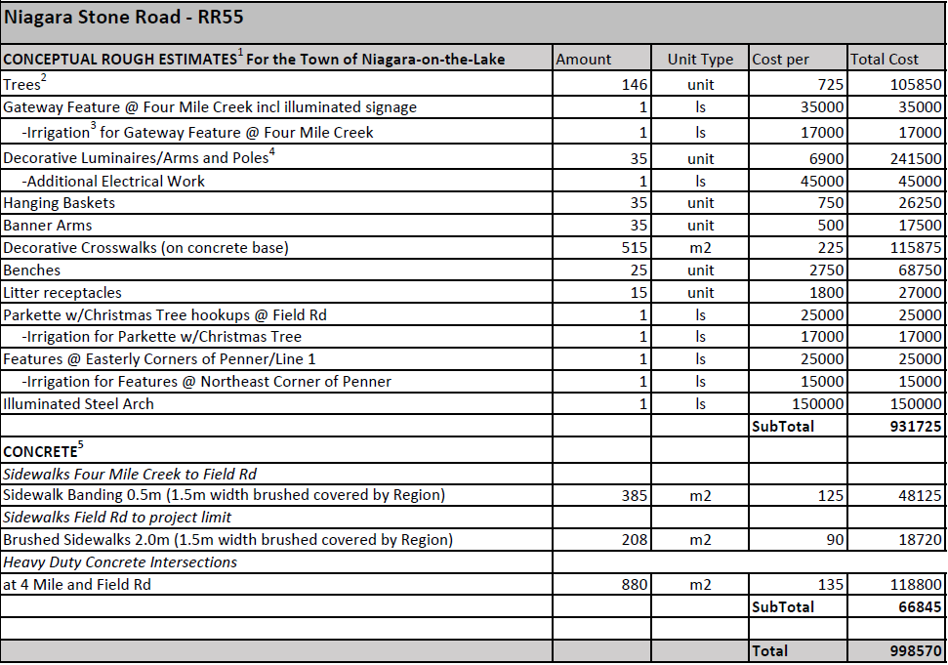

Slide 19
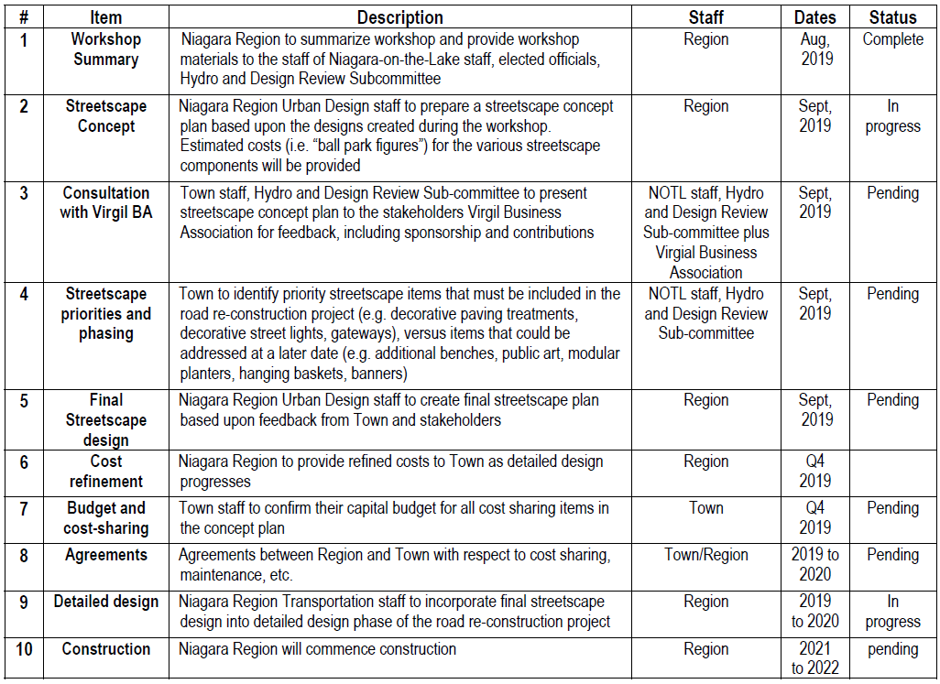

Slide 20
Queen Street Repairs and Facelift

Slide 21
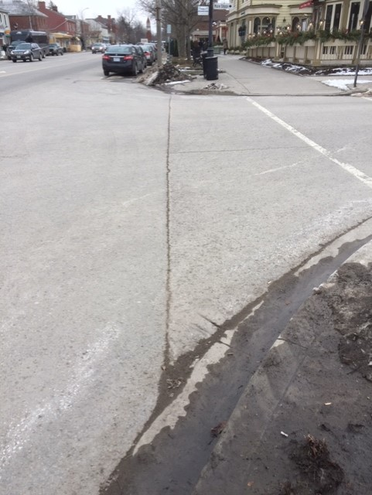
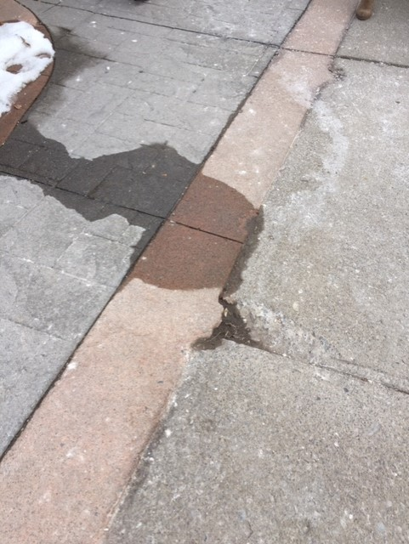
Queen Street

Slide 22
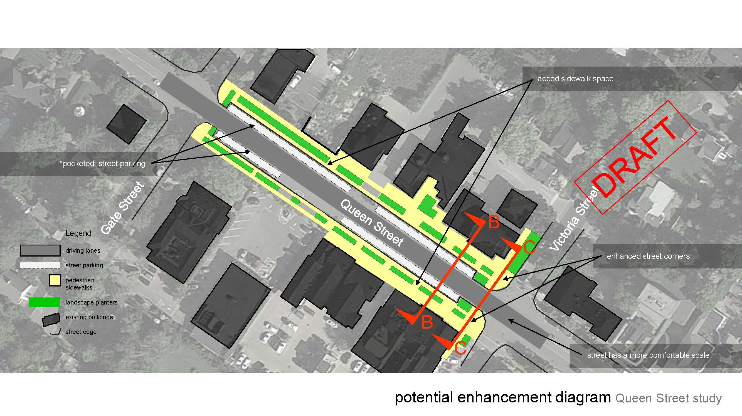
Queen Street Road and Sidewalk Reconstruction

Slide 23
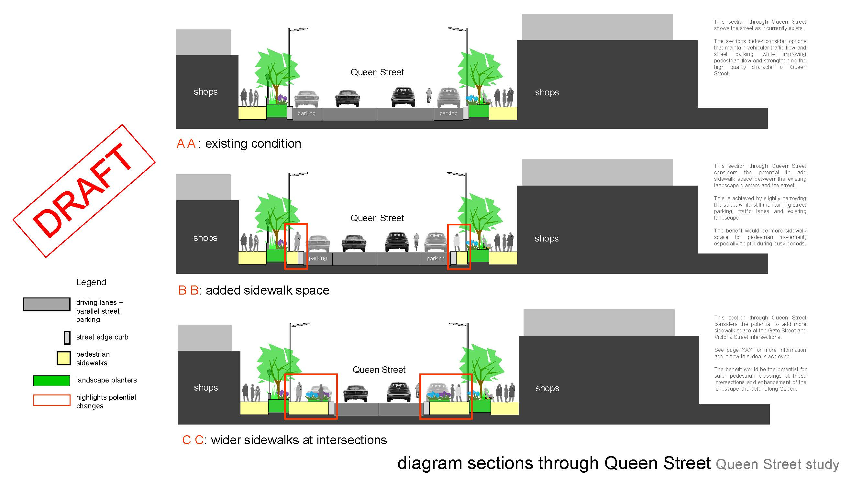
Queen Street Road and Sidewalk Reconstruction

Slide 24
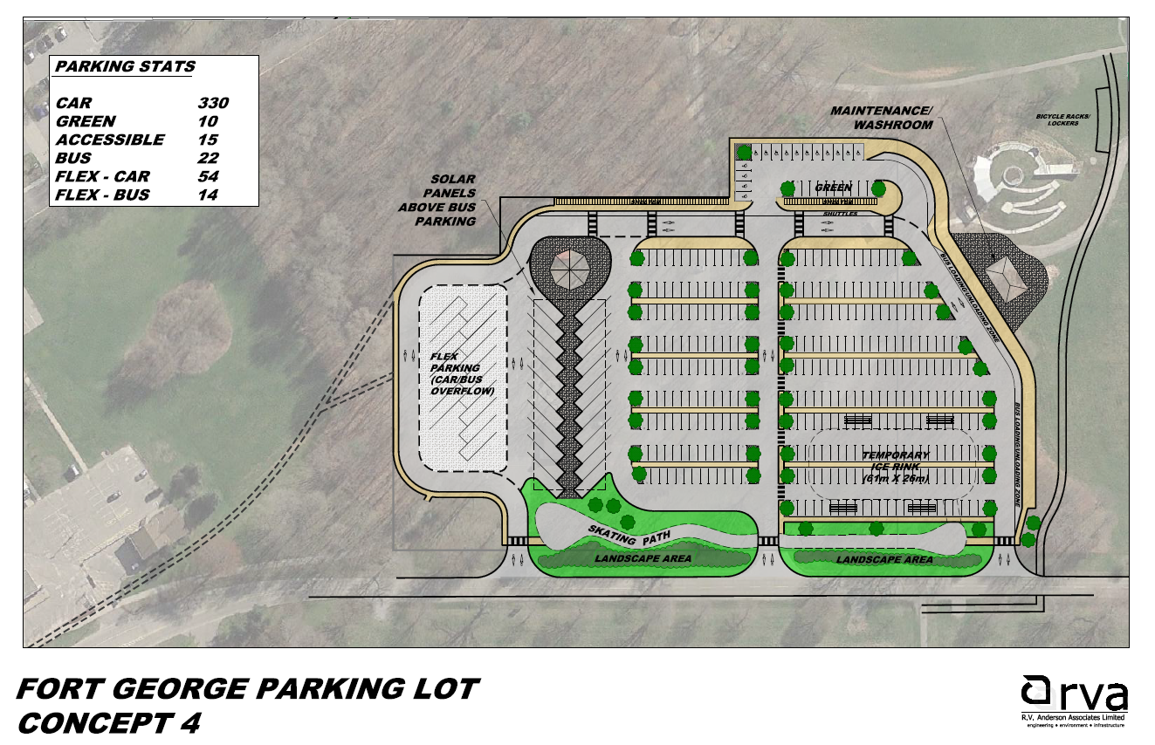

Slide 25
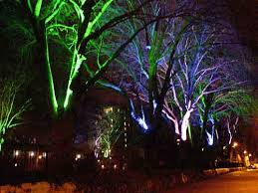
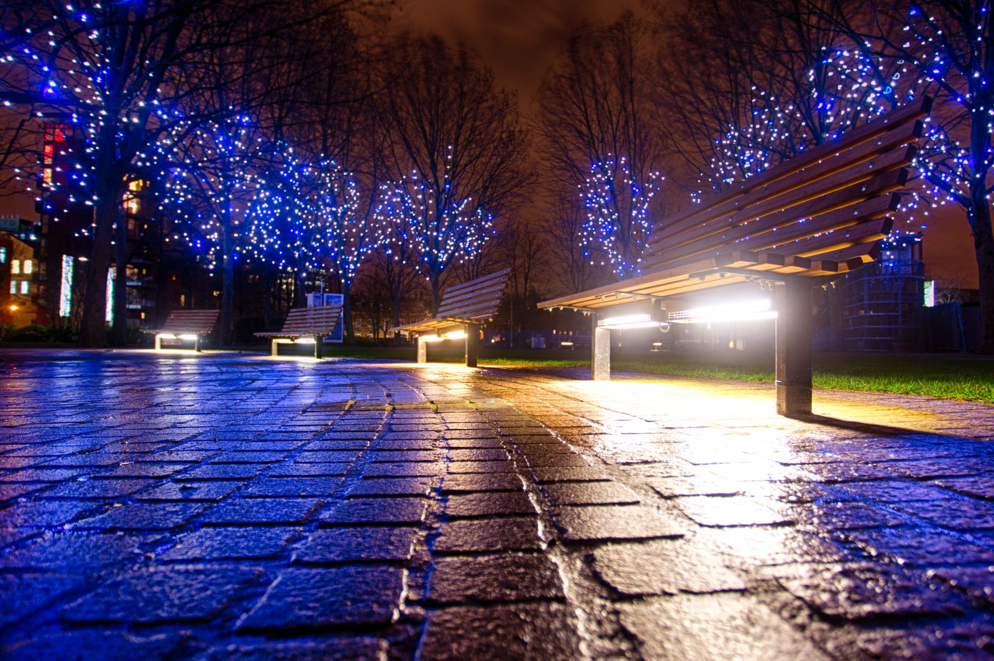
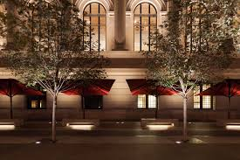
Tree Lighting

Slide 26
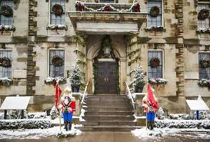
Christmas Decor

Slide 27
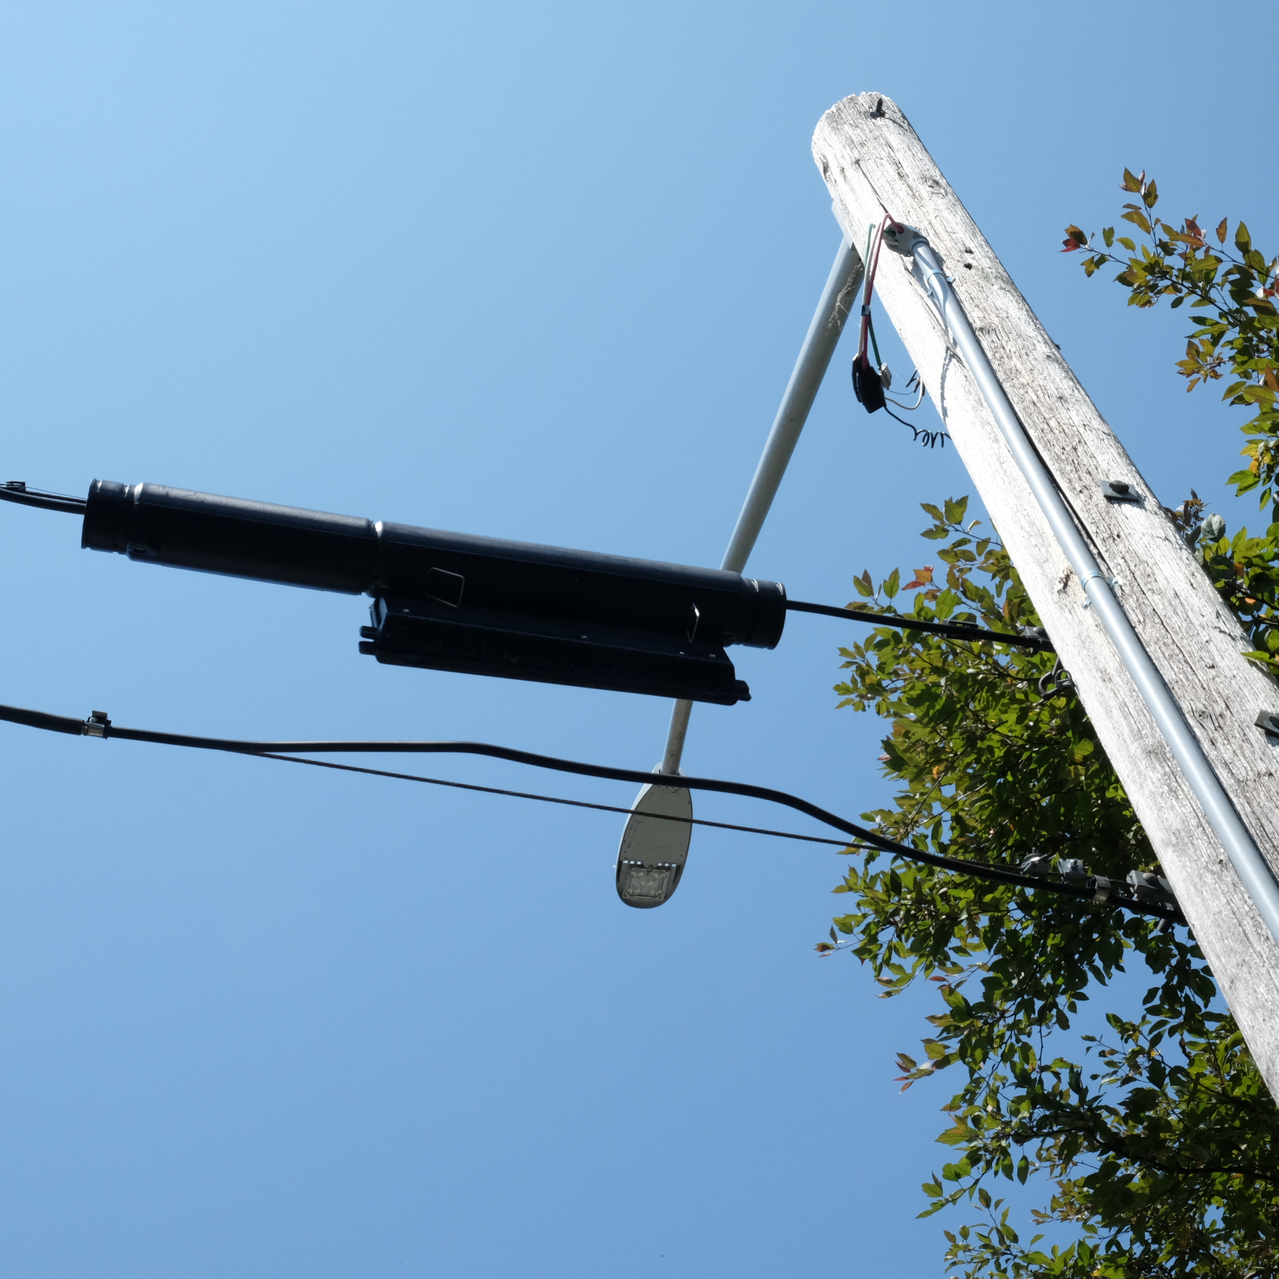
Lighting

Slide 28
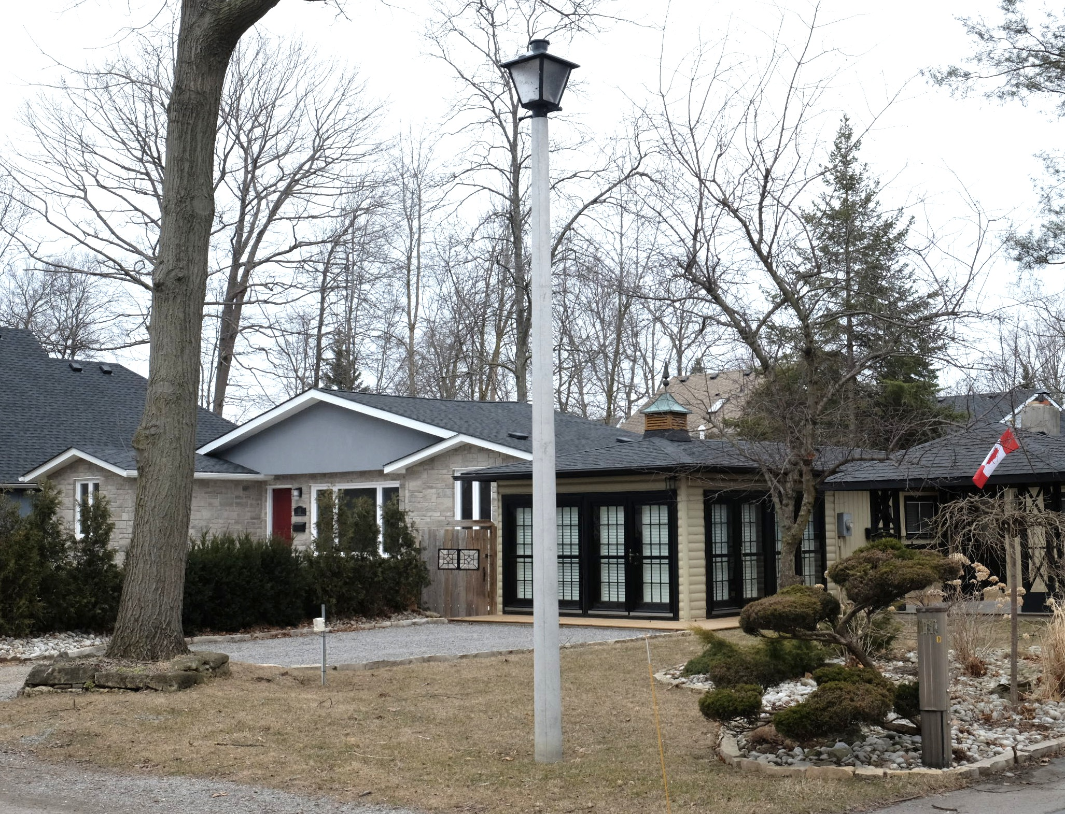
Lighting

Slide 29
Parking
The Town is short about 200 to 300 parking spaces in the Old Town
The digital economy is offering innovative ways to provide parking for municipalities
Wouldn’t it be great to provide a block of parking hours to residents to use as they see fit for themselves, guest, family, 2 hours, 5hours, 1 hour.

Slide 30
How will it Be Paid For
Refuse to do it
Raise Taxes
Raise User Fees
Public Fundraising
Borrow the Money
Municipal Accommodation Tax

Slide 31
Ontario Restaurant Hotel & Motel Association (ORHMA)
ORHMA has prepared the following recommendations to improve the MAT in Ontario:
Add an amendment to cap the MAT at 4%
The MAT tourism plan is approved by the local hotel association
Universities and Colleges to charge MAT on transient business
Exempt the credit card processing fee costs charged on the MAT

Slide 32
Tourism Industry Association of Ontario
Recommendations from TIAO regarding improvements to the MAT:
eligible stand-alone tourism entity within a 3-month time period from the pre-determined payment periods
Restricts the number of City representatives
the board of directors must be publicly elected by local tourism industry stakeholders (accommodations, restaurants, attractions, retail, tour operators, etc.)
Implement an official rate change process with 75% agreement from the Tourism Board.
TIAO recommend that funds collected through the MAT be used exclusively to augment current funding.

Slide 33
Creating a Partnership Contract to be a model for the Province Our Commitment
The board must be publicly elected by local tourism industry stakeholders One to two members of Council Representative | Agree Agree
An official rate change process for an increase or decrease of the MAT | Agree
Provide an opportunity for Accommodation Providers to deduct the credit card fee from the MAT contribution. | Agree

Slide 34
A partnership with the Tourism Industry Their Comitment
Creation of the Tourism Marketing Plan
A tourism plan that includes the aspects of our strategic plan and EDC objectives
A tourism plan that provides opportunities for all urban and rural areas to be presented within the marketing.

Slide 35
The Question What Potential Capital Improvements
Glendale Gateway
Airport Road and Queenston Road Welcome
Niagara Stone Road in Virgil
Queen Street Facelift
Christmas Decorations
Heritage Lighting
Fort George Welcome Centre and Parking a Partnership with Parks Canada
Lighting to the Gazebo – Wedding Icon
Parking
Public Washrooms
A percentage to these and a percentage to facilities master plan.
A tourism plan that includes the aspects of our strategic plan and EDC objectives
Queenston – partnership with NPC
St Davids Centre
A tourism plan that provides opportunities for all urban and rural areas to be presented within the marketing.
Other Ideas??

Slide 36
Request of Council
Ask Council to endorse putting this on the JTC page and start the public dialogue.

Slide 37
Questions

